Slide 1
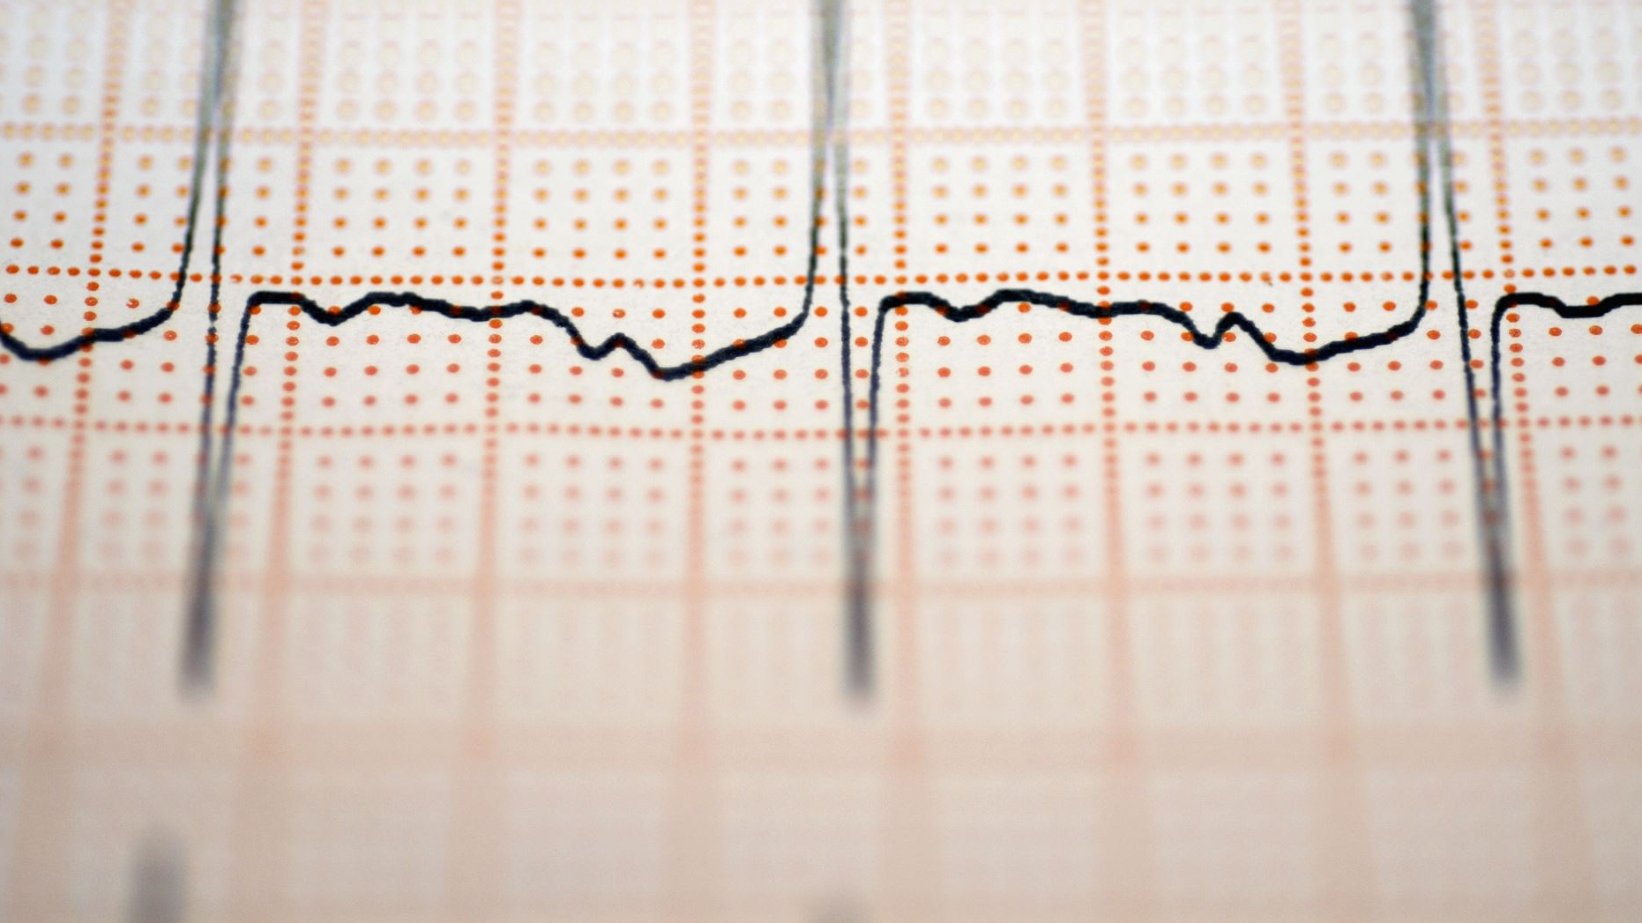
FPGA-Based Defibrillator Pulse Simulation Using ECG Signal Detection

Slide 2
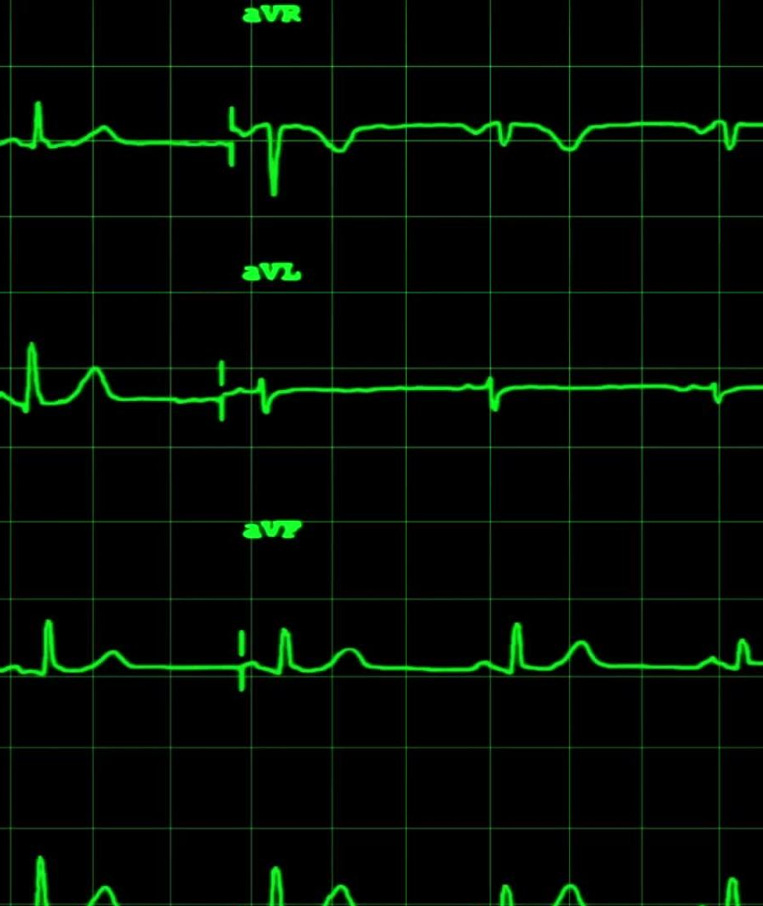
objective
To design and simulate a defibrillator pulse generator on FPGA that identifies abnormal cardiac rhythms using real-time ECG signal detection.
To implement an efficient Verilog-based finite state machine (FSM) for reliable recognition of arrhythmia events and trigger appropriate defibrillation pulses.
To validate the accuracy and responsiveness of the system using synthesized ECG data, ensuring timely and safe pulse delivery.
Ventricular fibrillation (VF): The heart’s electrical signals become chaotic, and the ventricles quiver instead of pumping blood.
Ventricular tachycardia (VT): The ventricles beat too fast, which can lead to collapse and cardiac arrest.

Slide 3
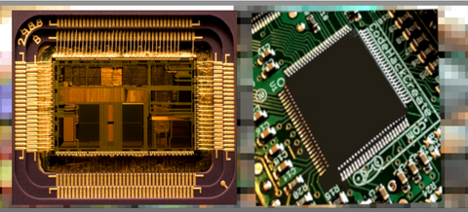
WHY FPGA ?
FPGAs are ideal for medical devices like defibrillator simulators because they deliver real-time.
high-speed parallel processing, flexible and reconfigurable logic, and support rapid prototyping and field updates.
timely response, future-proofing, and custom hardware performance critical for patient safety and evolving healthcare standards

Slide 4
methodology
Load ECG Data ECG data is loaded from a CSV file with sampling frequency set to 360 Hz.
Filter the Signal​ A 0.5–40 Hz bandpass Butterworth filter removes baseline drift and high-frequency noise.​
Find R-Peaks​ R-peaks are detected using a threshold-based peak detection method with minimum distance.
Calculate RR Intervals​ RR intervals are obtained by measuring time differences between consecutive detected R-peaks.​
Detect Abnormal Rhythm​ Intervals shorter than 0.6 s or longer than 1.2 s indicate possible arrhythmia.
Simulate Defibrillator​ Abnormal rhythms trigger console warnings and beep sound feedback simulating defibrillator activation.​
Plot ECG with Markers​ Filtered ECG is plotted with red R-peak markers and abnormal trigger lines.
Show Normal Segment​ A normal 10–20 second ECG segment is plotted to serve as healthy reference.
Show Abnormal Segment (if any)​ ECG around abnormal event is highlighted with shaded region indicating defibrillator trigger.

Slide 5

How do we find it’s abnormal rhythm
Condition | RR Interval | Heart Rate
Normal | 0.6 – 1.2 sec | 50 – 100 BPM
Tachycardia | < 0.6 sec | > 100 BPM
Bradycardia | > 1.2 sec | < 50 BPM
What Are Abnormal Rhythms?
The RR interval is the time gap between two R-peaks in the ECG signal.
A short RR interval = fast heartbeat = Tachycardia
A long RR interval = slow/missed heartbeat = Bradycardia

Slide 6



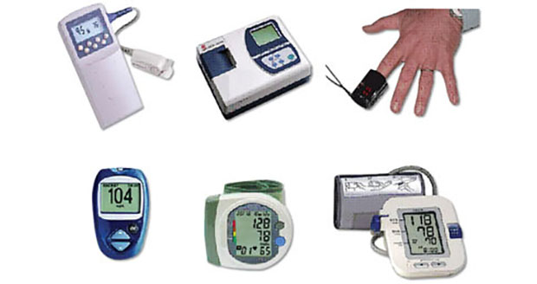
Applications
Smart Ambulance Systems
Embedded in ambulance to detect abnormal ECG patterns and auto-trigger alerts or instructions to paramedics.
Remote Patient Monitoring
In telemedicine, helps doctors track patient ECG data and simulate responses in real-time from a remote location.
Smart Wearable Health Devices
Can be integrated into smartwatches or fitness bands to monitor heartbeat and simulate alerts for abnormal patterns.
Automated External Defibrillator (AED) Testing
Used in the testing and simulation of defibrillator logic without applying real shocks.

Slide 7
Paper analysis
Modifications and Contributions in This Work:
Hardware-Efficient Design:
Optimized the signal processing and detection algorithms for low power and low area FPGA implementation.
Fully FPGA-Based Pipeline:
No external processor or software used — the entire process (filtering, detection, control) is implemented on hardware.
Improved Accuracy Over Software-Only Methods:
Compared to earlier MATLAB-based or microcontroller-based systems, this design offers real-time response with higher accuracyand less delay.
Portable and Low-Power Design Targeted
Approach Used in the Paper:
Real-Time ECG Acquisition and Processing on FPGA:
Uses real or stored ECG signals processed live using FPGA for faster response.
R-Peak Detection Algorithm:
Uses a threshold-based peak detection algorithm, optimized for hardware implementation.
Finite State Machine (FSM) for Rhythm Detection:
An FSM is designed to analyze RR intervals between detected R-peaks.
If RR interval is too long or too short → abnormal condition detected.
Simulation of Defibrillator Pulse:
Instead of triggering a real shock, a simulated pulse signal is generated when abnormal heart rhythm is found.
Timing and Control Modules:
Custom timing blocks created to measure intervals and detect bradycardia/tachycardia in real time.

Slide 8
Conclusion
Real-time ECG signal analysis was successfully implemented on FPGA.
Efficient R-peak detection was achieved using a threshold-based method.
FSM logic detected abnormal rhythms accurately via RR intervals.
A simulated defibrillator pulse was triggered for abnormal cases.
Design is low-power, fast, and suitable for portable devices.

Slide 9
Thank you
BY Group-2: 2310040032 – M. Sravya 2310040077 – T. Tejaswini Reddy 2310040041 – K. Pranay Reddy 2310040044 – S. Bala Sai Ram

